Slide 1

Phonics Screening Check

Slide 2
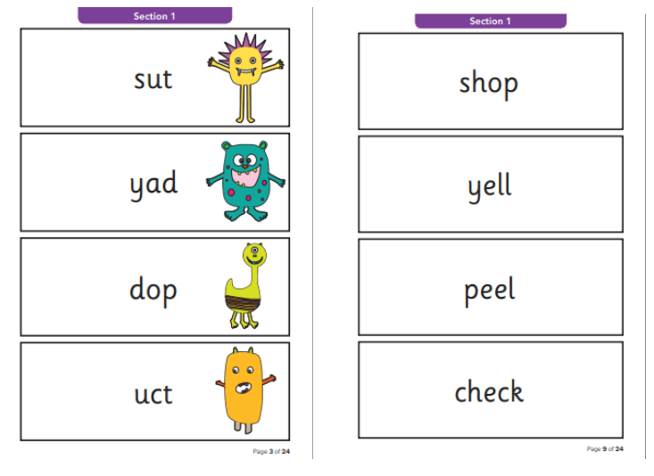
The Phonics Screening Check
What is the Phonics Screening Check?
It is a quick check of your child’s phonics knowledge.
It is not designed to create any stress or anxiety for your child.
It assesses decoding skills using phonics.
It consists of 40 words (20 real words,
20 ‘alien words’).
If children do not achieve the required score in Year 1, they will retake the screening at the end of Year 2. If your child needs further support their teacher will contact you.
Notes:
Slide purpose:
To introduce the Phonics Screening Check.
Suggested script:
Read the slide.

Slide 3
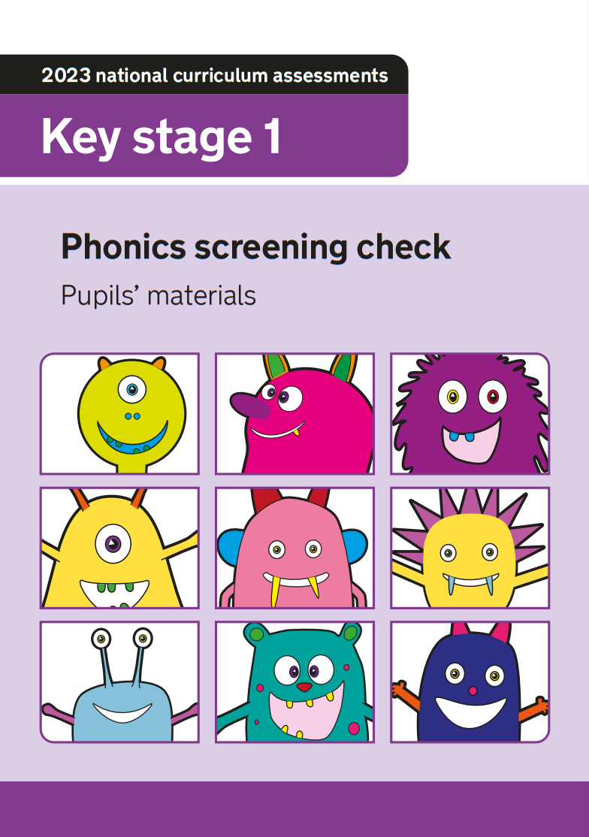
How does the check work?
Your child will be with their class teacher.
They will be asked to read 40 words aloud. It can be completed in 2 parts if they need a break but must completed on that day.
This takes just a few minutes to complete, but there is no time limit.
If your child is struggling, the teacher will stop.
It has been carefully designed not to be stressful for your child and they usually enjoy it!
Notes:
Slide purpose:
To provide an overview of the Phonics Screening Check.
Suggested script:
Staff will use their judgement on whether they feel children need a break from reading the 40 words.
If staff feel that the check is too much, they will stop.

Slide 4
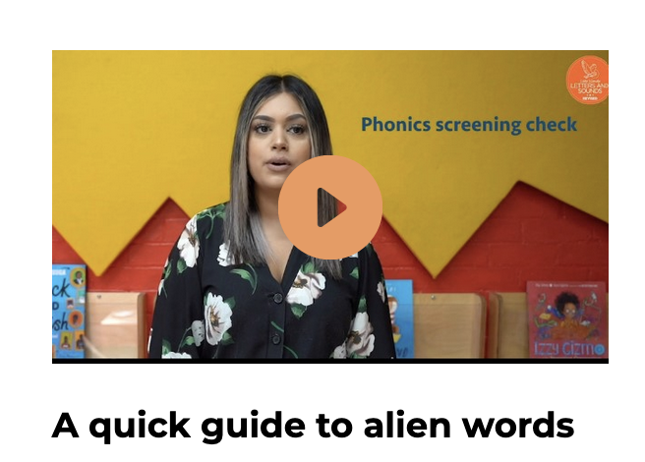
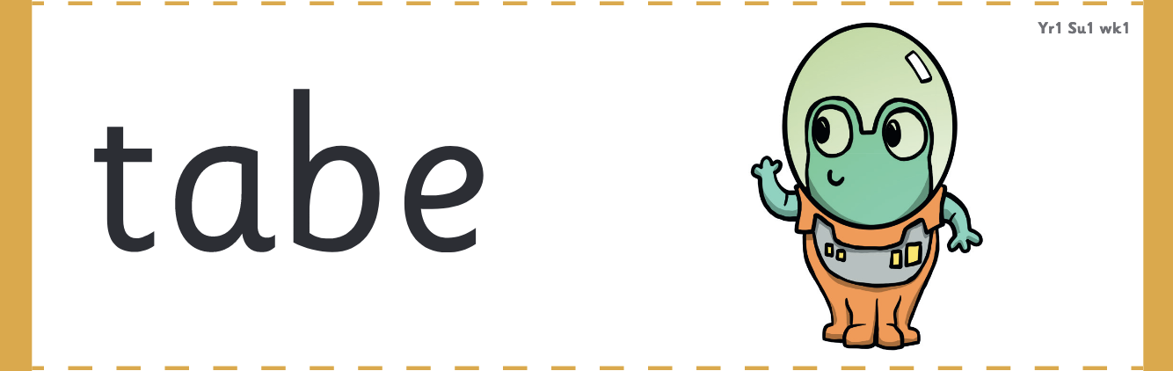
What are ‘alien words’?
Notes:
Slide purpose:
To introduce ‘alien words’.
Suggested script:
Let's watch this short film – that you can find on the Parent pages of the Little Wandle website – which explains alien words and why they are used in the PSC.

Slide 5
‘Alien words’ recap
The check will contain 20 ‘alien words’.
The children will be familiar with alien words and will start to read them this term.
Alien words assess children’s decoding skills and are used in lessons for the purpose of preparing for the Phonics Screening Check only.
Children cannot read these words by using their memory or known vocabulary, so they have to use their decoding skills. This is a fair way to assess their ability to decode.
The Phonics Screening Check will be administered in June.
Notes:
Slide purpose:
To provide an overview of ‘alien’ words
Suggested script:
A lot of the phonics curriculum is now focusing on getting children to read fluently. However, we will teach children to only sound and blend alien words. This is because we want children to be accurate – speedy doesn’t always do it!

Slide 6
How to read a word
snarl
fighb
Look at the word.
Can they see a digraph (2 letters, 1 sound) or trigraph (3 letters, 1 sound)?
Say it.
Sound talk - using their finger under each sound ( s-n-ar-l or f –igh-b)
Blend and read the word.

Slide 7
Common mistakes when reading alien words.
*Making alien words into real words
strom storm
blane plane
strape strap
fram farm

Slide 8
Common mistakes when reading alien words.
*Mixing up b and d
keb ked
drad drab
scrab scrad
mud mub

Slide 9
Common mistakes when reading alien words.
*Not identifying split vowel digraphs
plame
heme
frope
slipe
drube

Slide 10
How can you help?
To practise unknown sounds – each child’s personalised list will be sent out regularly.
Read with your child regularly.
Encourage their child to look carefully at the words – looking at which digraphs or trigraphs they know and can use ‘sound talk’ to read the word.
Google Classroom – some phonics resources will be available for you to practise.

